Slide 1

EncryptNotes
Phase 2
Team 2
Duncan, Kurejake, Jacob, Grant, Kaden

Slide 2
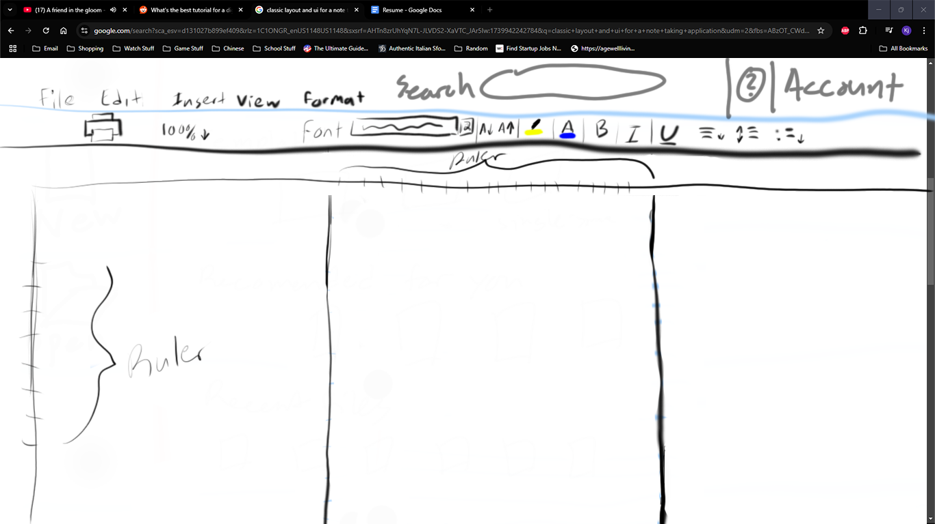
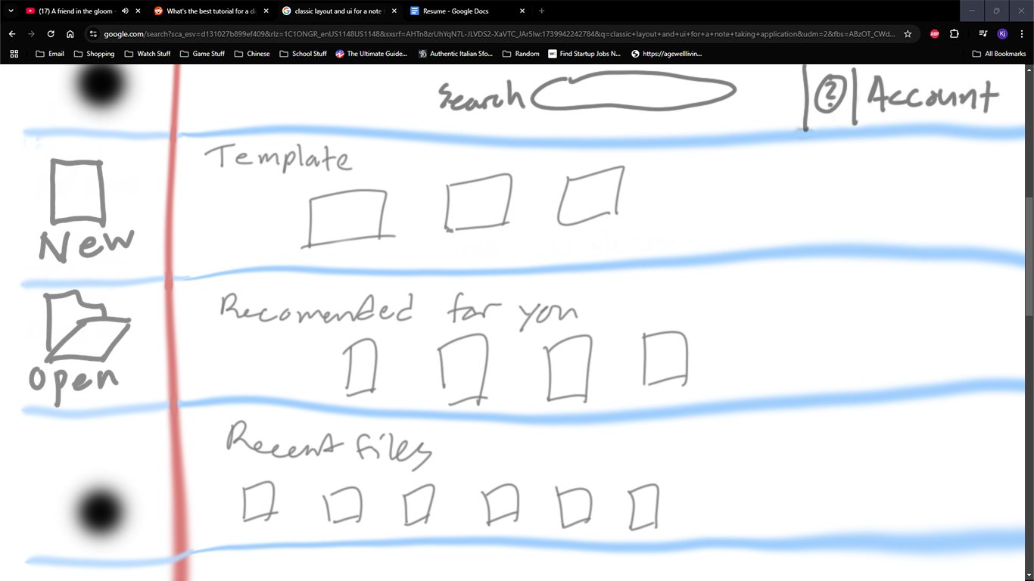
Beginning Phase 2
We Started by Creating the Front-end
We created a draft, then from there started work
We followed the rough the idea of how it was going to look
As we create the front-end, we tweaked it as needed

Slide 3
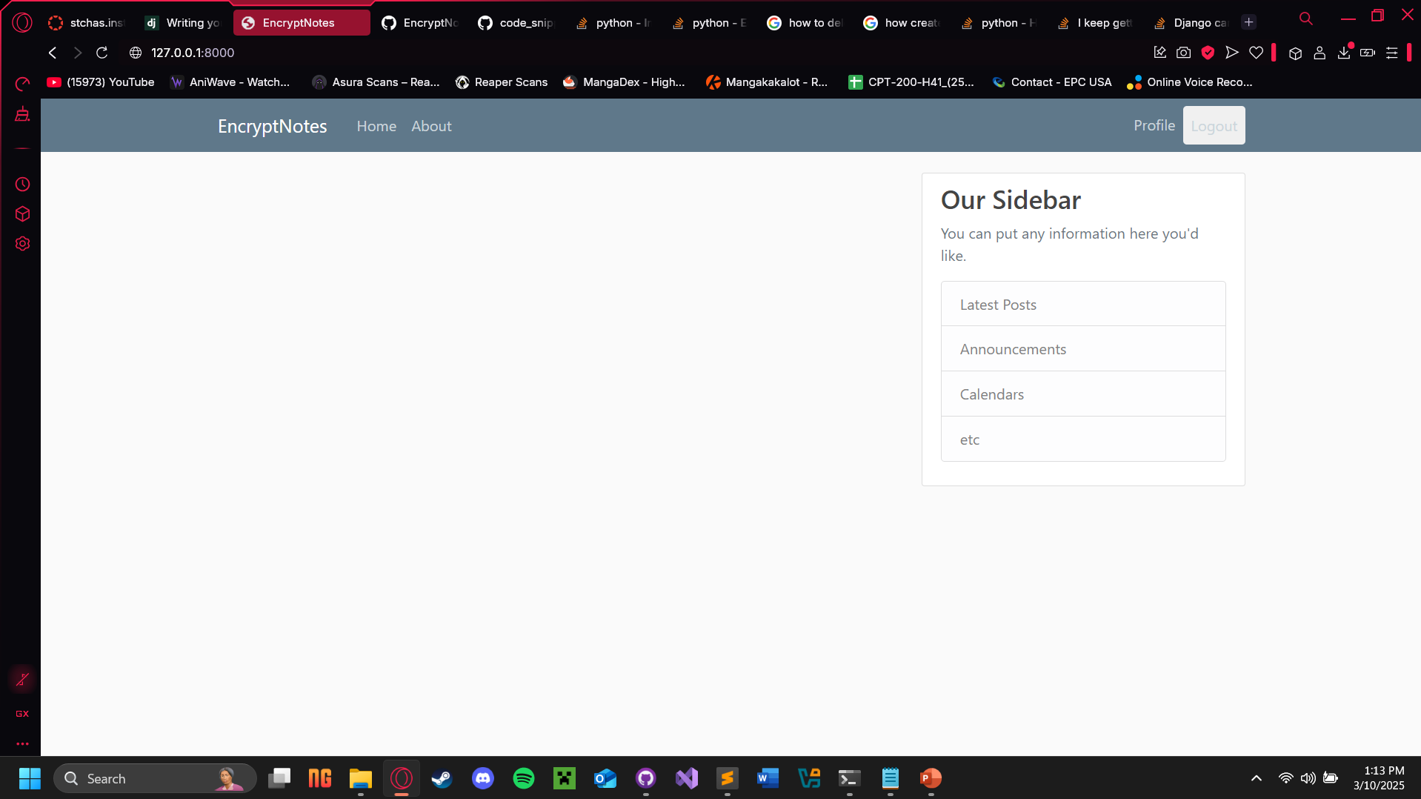
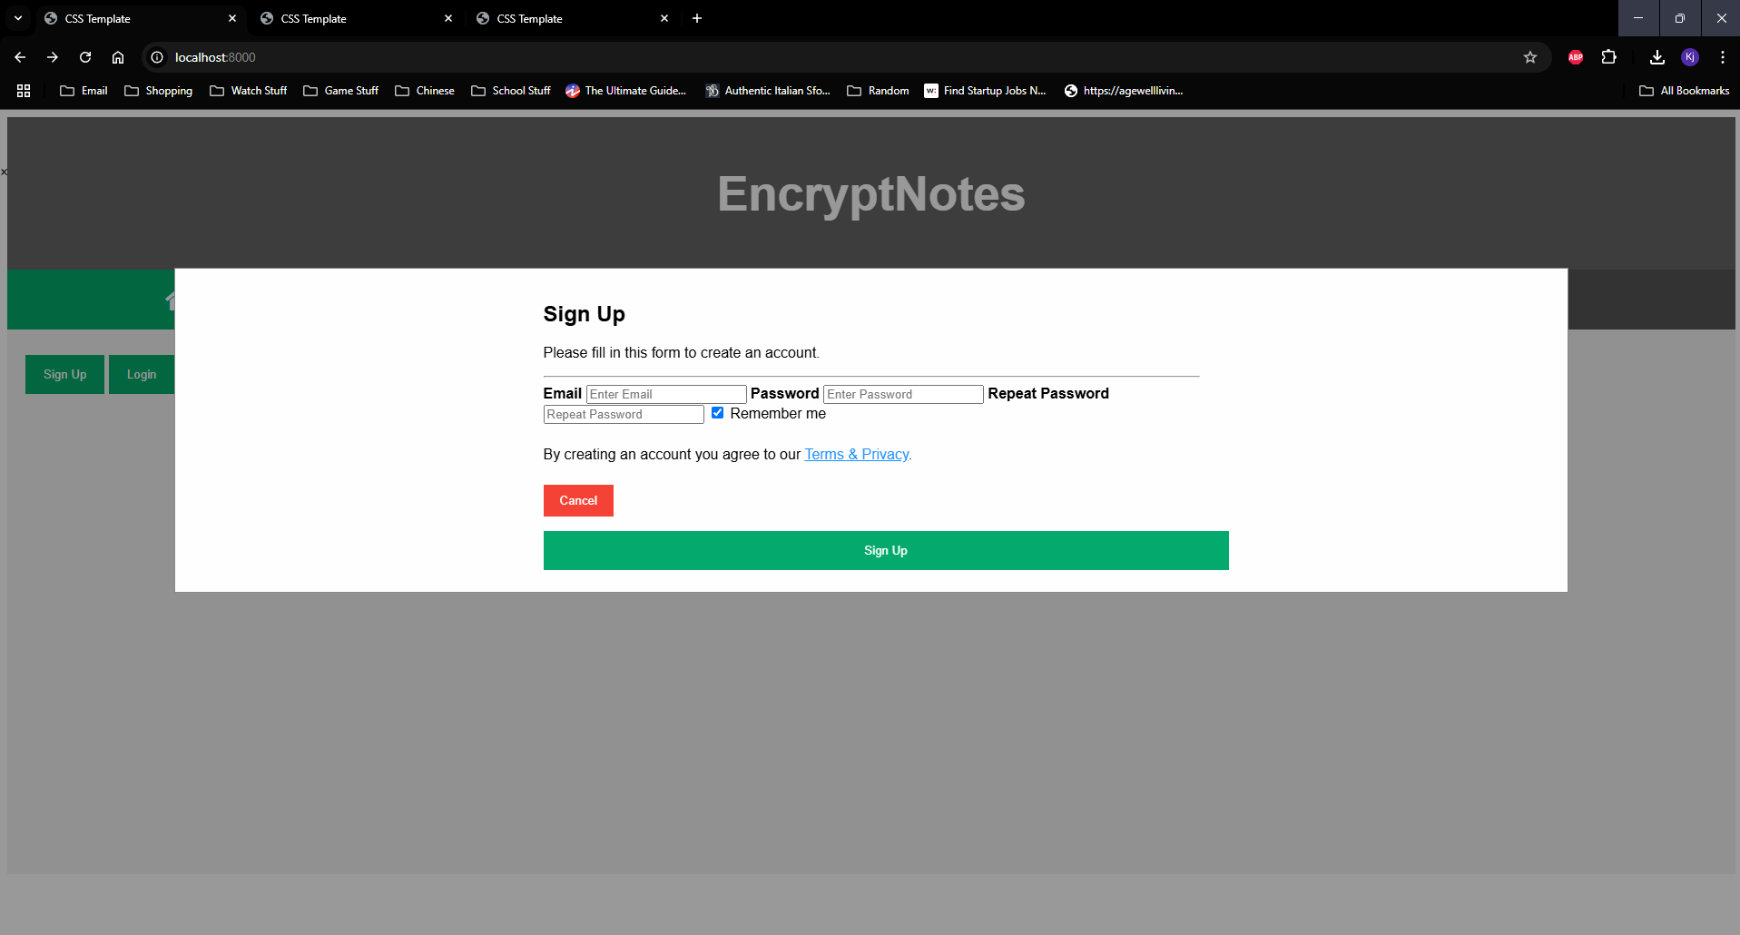
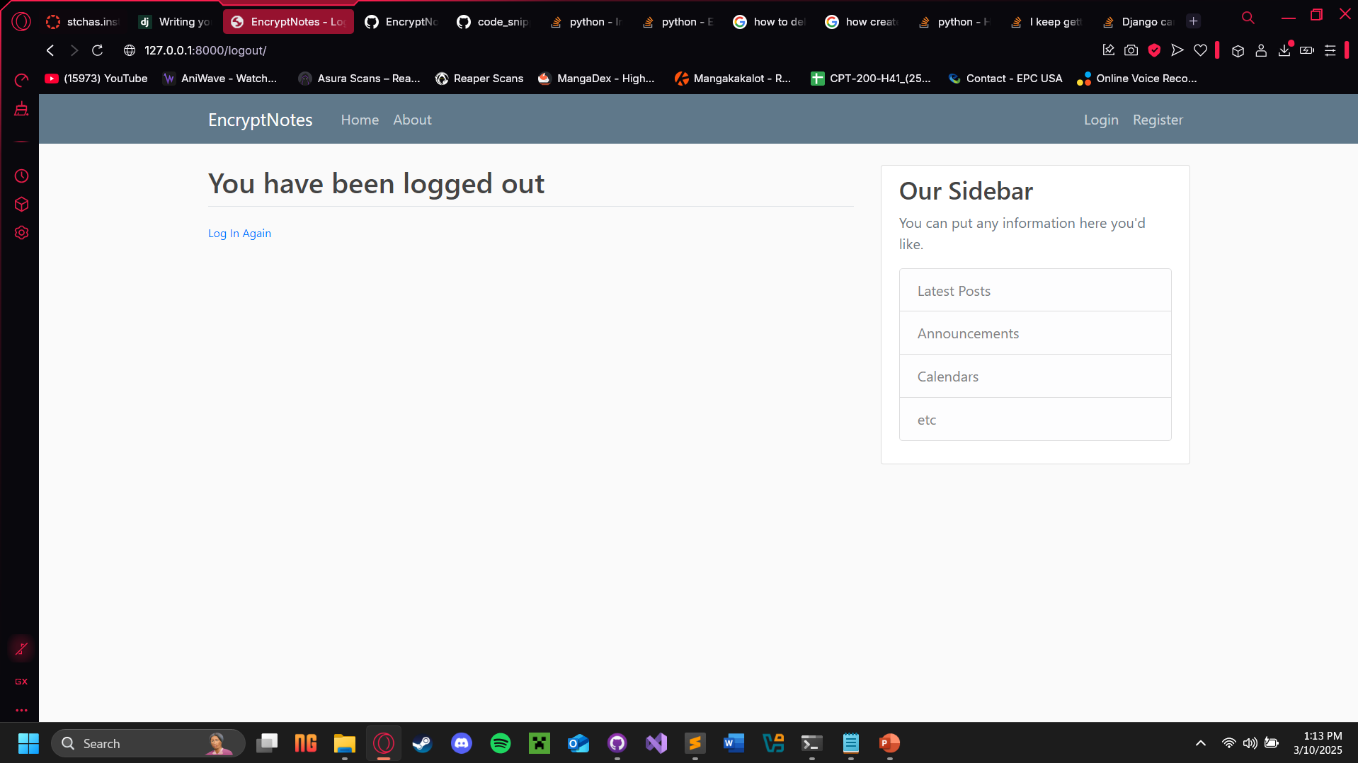
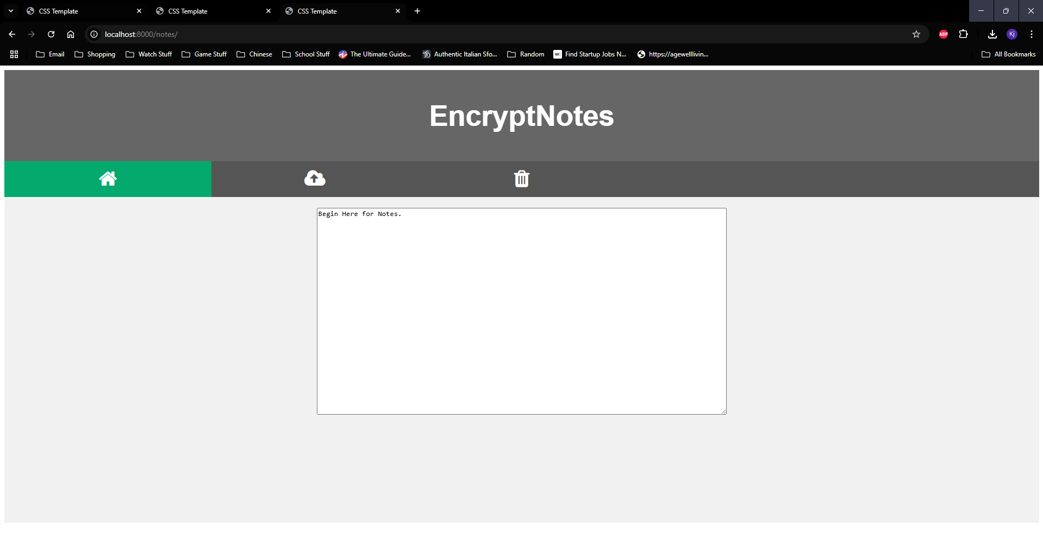
Current and Past Front-end

Slide 4
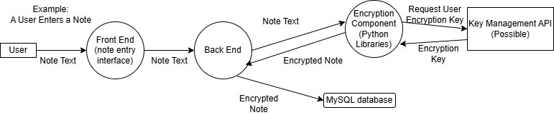
User Note Entry Process

Slide 5
Paperwork
We added all documents templates to the GitHub and then renamed them
Then we all later started to add pieces what of we did and completed parts of the documents
The Gantt Chart, Duration Estimate, Milestone list, and System Design Documents
Adding dates for task dates, Milestones, and each separate category on the System Design Document

Slide 6
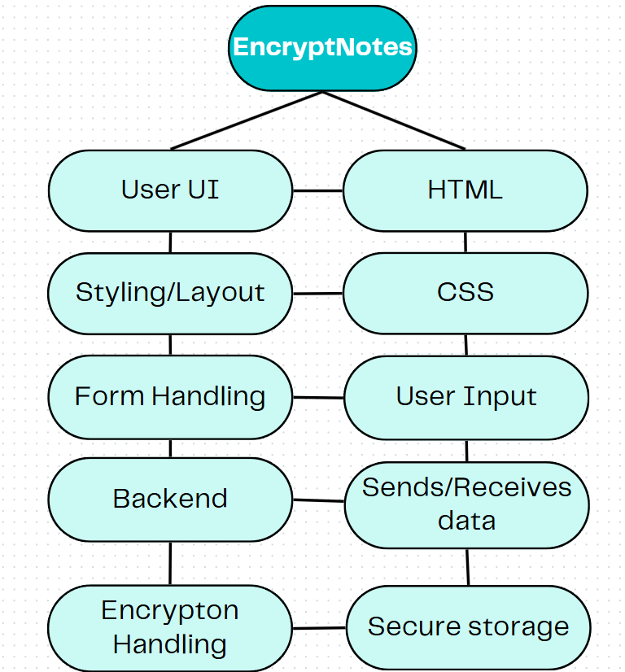
Architecture diagram

Slide 7
APIs/technology used
Google Drive API
Google Sign-In API
Google Cloud Secret Manager (possible)

Slide 8
The Back-end
We started by creating a basic model and ran some tests to make sure it properly connects to the front-end
From there we had work out (At least to somewhat working)

Slide 9
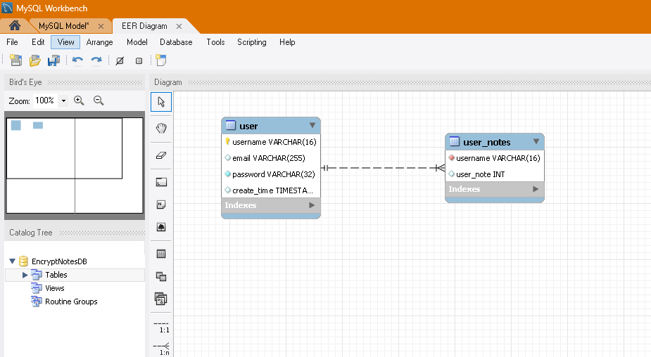
The Back-end
We for this phase have it at least store user data (usernames, emails, etc.)
We also started looking over documents for implementing Python Cryptodome to encrypt the data

Slide 10
Back-end Security
Our other focus is reinforcing our encryption of the database
Python has libraries that allow us to easily use .env files to hide sensitive variables for our AES while keeping them available to the program

Slide 11
Questions?

